Slide 1
GLOBAL SUPERSTORE
nwaigwe caleb chimdi

Slide 2
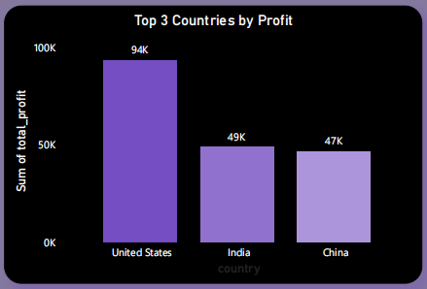
What are the three countries that generated the highest total profit for Global Superstore in 2014?
The Top 3 Countries that generated the highest total profit for Global Superstore in 2014 are: United States with a profit of 94k India with a profit of 49k
China with a profit of 47k

Slide 3
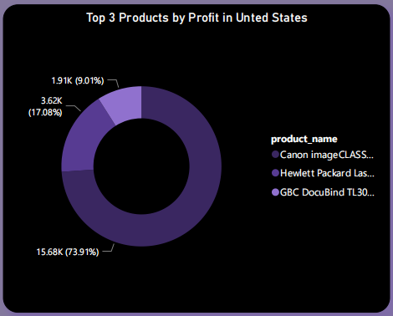
The top 3 product names for the United states
The Top 3 product names for the United States are
Canon imageCLASS 2200 Advanced Copier with total profit of 15679.9552
Hewlett Packard LaserJet 3310 Copier with total profit of 3623.9396
GBC DocuBind TL300 Electric Binding System with total profit 1910.5887000000002

Slide 4
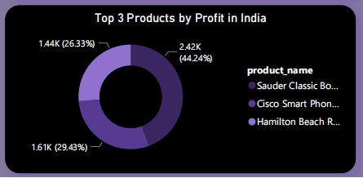
The top 3 product names for the India
The Top 3 product names for India are
Sauder Classic Bookcase, Traditional with total profit of 2419.65
Cisco Smart Phone, with Caller ID with total profit of 1609.38
Hamilton Beach Refrigerator, Red with total profit 1440.24

Slide 5
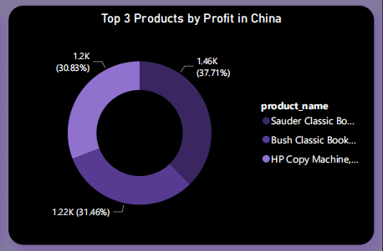
The top 3 product names for the China are
The Top 3 product names for China are
Sauder Classic Bookcase, Traditional with total profit of 2419.65
Cisco Smart Phone, with Caller ID with total profit of 1609.38
Hamilton Beach Refrigerator, Red with total profit 1440.24

Slide 6
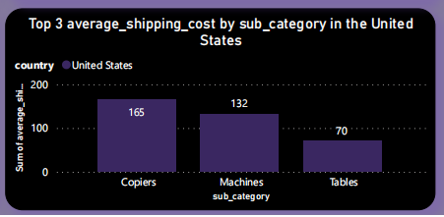
The 3 subcategories with the highest average shipping cost in the United States.
The 3 Subcategores with the highest average shipping cost in the United States are
Copiers with an average shipping cost of 165.2
Machines with an average shipping cost of 132.2
Tables with an average shipping cost of 69.9

Slide 7
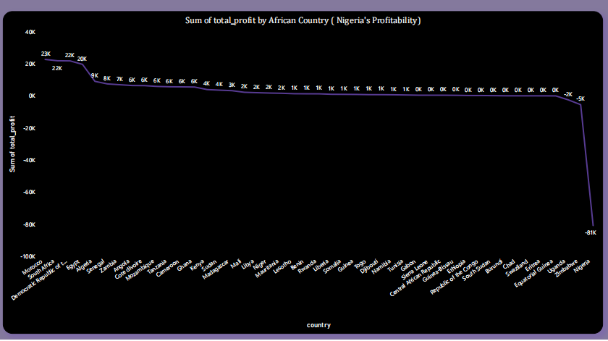
How does Nigeria profitability compare to other African countries?
Nigeria’s profitability compared to other African countries shows that Nigeria is the least profitable of the African countries with a profit of -81k.

Slide 8
What factors might be responsible for Nigeria’s poor performance?
I analyzed to understand Nigeria's poor performance. The focus was on the discounts offered by Nigeria. It was found that Nigeria had the highest average discount compared to other countries that year. Zimbabwe and Uganda also had the same average discount and faced a loss in profitability.
Discounts play a crucial role in revenue and profitability. While discounts can boost sales and profits in some cases, this wasn't the case for Nigeria in 2014. The high average discount in Nigeria likely led to reduced revenue and a decline in profitability.
Furthermore, Nigeria had the highest shipping costs among African countries. These high shipping expenses put significant pressure on the overall revenue. The combination of high discounts and elevated shipping costs resulted in a decrease in profit for Nigeria.

Slide 9
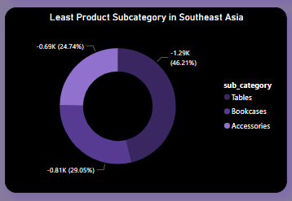
Which product subcategory has the highest average profit in Australia?
The product subcategory that is the least profitable in Southeast Asia is Tables with a loss of -1294.3503

Slide 10
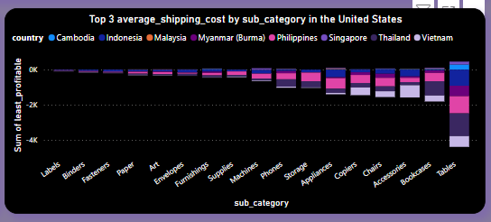
Is there a specific country in Southeast Asia where Global Superstore should stop offering the subcategory?
The country Global Superstore should stop offering the subcategory identified is Thailand

Slide 11
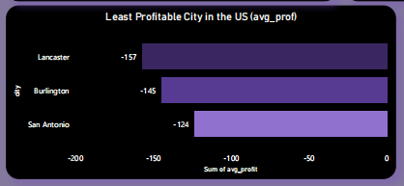
Which city is the least profitable (in terms of average profit) in the United States?
The city of Lancaster is the least profitable (in terms of average profit) in the United States with an average profit of -157.37105217391306

Slide 12
Why is this city’s average profit so low?
High Shipping Costs: The shipping costs for products sold in Lancaster seem to be relatively high, which can eat into the profit margin.
Discounts Impact: Some products in Lancaster have significant discounts applied to them, which can reduce the overall profit earned from those sales.
Low Sales Prices: The sales prices of some products in Lancaster appear to be relatively low, which may contribute to lower profit margins.
Product Costs: The cost of some products may be high compared to the selling price, resulting in lower profits for the city of Lancaster.

Slide 13
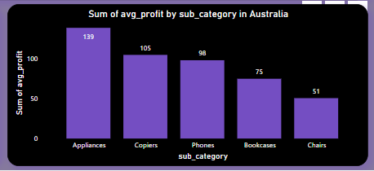
Which product subcategory has the highest profit in Australia?
Appliances has the highest average profit product subcategory in Australia with an average profit of 139.01

Slide 14
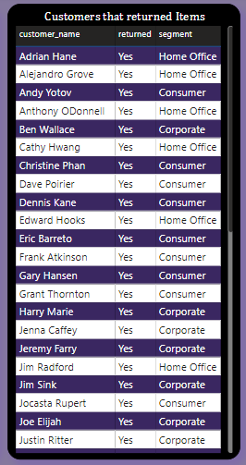
Customers that returned items and what segment they belong to

Slide 15
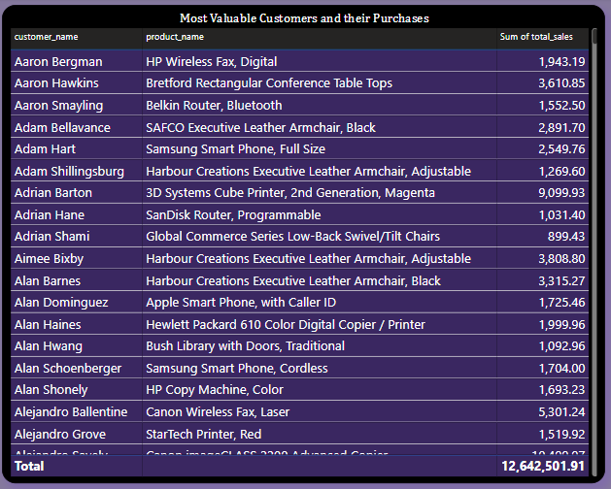
Most valuable customers

